Slide 1
TAS152
LECTURE 7
TOPIC 1
CYBER SOCIETY: CORE VALUES AND VIRTUES
1.8 CYBER CAPITALISM

Slide 2
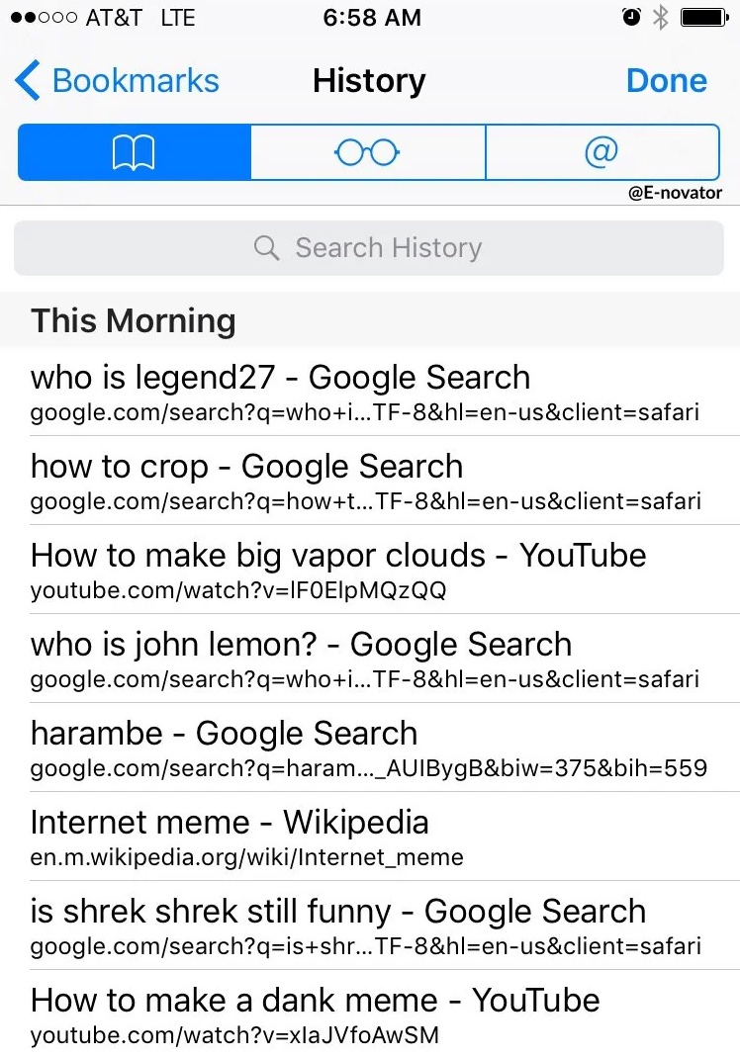

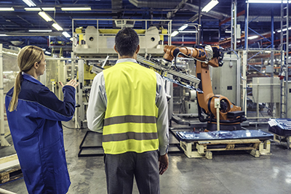

CLASSICAL PRODUCTION FACTORS
1 – Natural resources
2 – Human labour
3 – Capital
4 – Big data

Slide 3

DATA BROKERS
User data is valuable, why?
Where does user data come from?
Users consent to their data being collected and shared.
Whether users consent to their data being sold to third parties is debatable...
What do data brokers do?

Slide 4
WHAT CAN USERS DO TO PROTECT THEIR DATA?
You can take actions yourself:
Ask companies to show you what data they have of yours.
https://support.google.com/accounts/answer/162744?hl=en
Opt out of having your data collected.
https://help.openai.com/en/articles/5722486-how-your-data-is-used-to-improve-model-performance
Demand that your data be removed from their servers, if they do have it.
https://www.spotify.com/za-en/legal/privacy-policy/
You are also protected by laws:
POPI (South Africa)
GDPR (Europe)

Slide 5
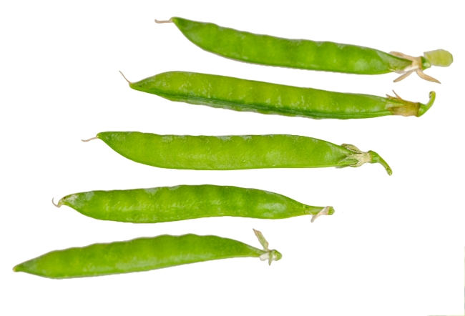
THE 5 Ps OF ETHICAL DATA HANDLING
1 – Provenance
Origin of the data must be known.
Acquired legally and with full consent of the user.
2 – Purpose
Used in the way that the user consented to.
Not repurposed and used differently.
3 – Protection
Protected when stored and transferred.
Destroyed after a certain period.
4 – Privacy
Sufficiently anonymized before it is used.
Record kept of who has access to the unanonymised data.
5 – Preparation
Techniques used to process the data must be documented.
Accuracy and validity of the data must be verified.

Slide 6












FAMOUS SOUTH AFRICAN TECH COMPANIES

Slide 7
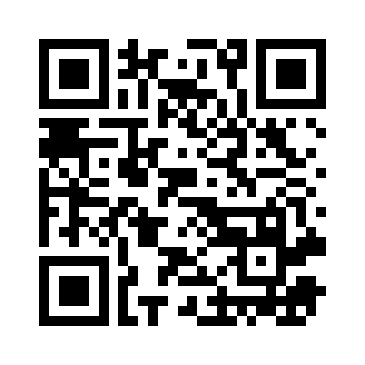
ACTIVITY - STRAWPOLL
When using an AI chatbot for customer service, should the customer be told that they are speaking to an AI chatbot, or is it okay to make them think that they are speaking to a human?

Slide 8
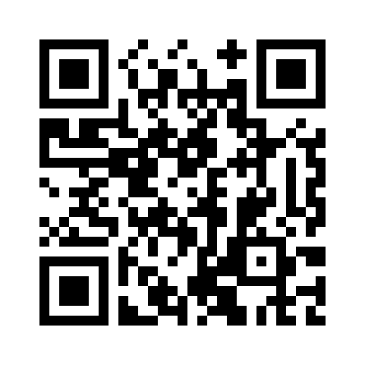
ACTIVITY - STRAWPOLL
A hospital has two patients in need of a heart transplant. Only a single heart becomes available for transplant.
What is the most ethical way to select the recipient?

Slide 9
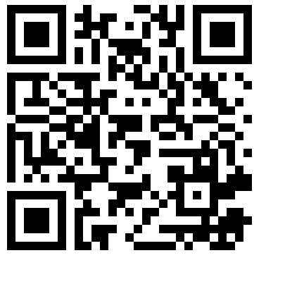
ACTIVITY - STRAWPOLL
Mary lives only in a single black and white room.
She reads black and white books and uses screens that only display images in black and white
to learn everything. She knows that colour exists and has learnt about colour using physics
and biology books. One day, her computer screen breaks and displays the colour red. For the
first time, she sees colour.
Is it possible for her to learn something new (something she wasn't able to learn in black and
white) now that she is able to see colours?

